Slide 1


Maharaja Institute of Technology Thandavapura
(Approved by AICTE, New Delhi & Affiliated to VTU, Belagavi)
Department of Computer Science and Engineering
(Artificial Intelligence and Machine Learning)
Online Voting System Using Face Recognition And Liveness Detection
Team Members: Guide:
Bhanu Prakash BC (4MN23CI008) Prof.Sandhya R.
Madhushree KR (4MN23CIO24)
Priyanka HB (4MN23CI033)
Madhusudhan S (4MN24CI403)
Reference Link:: VOTUM: Secure and Transparent E-Voting System | Springer Nature Link

Slide 2
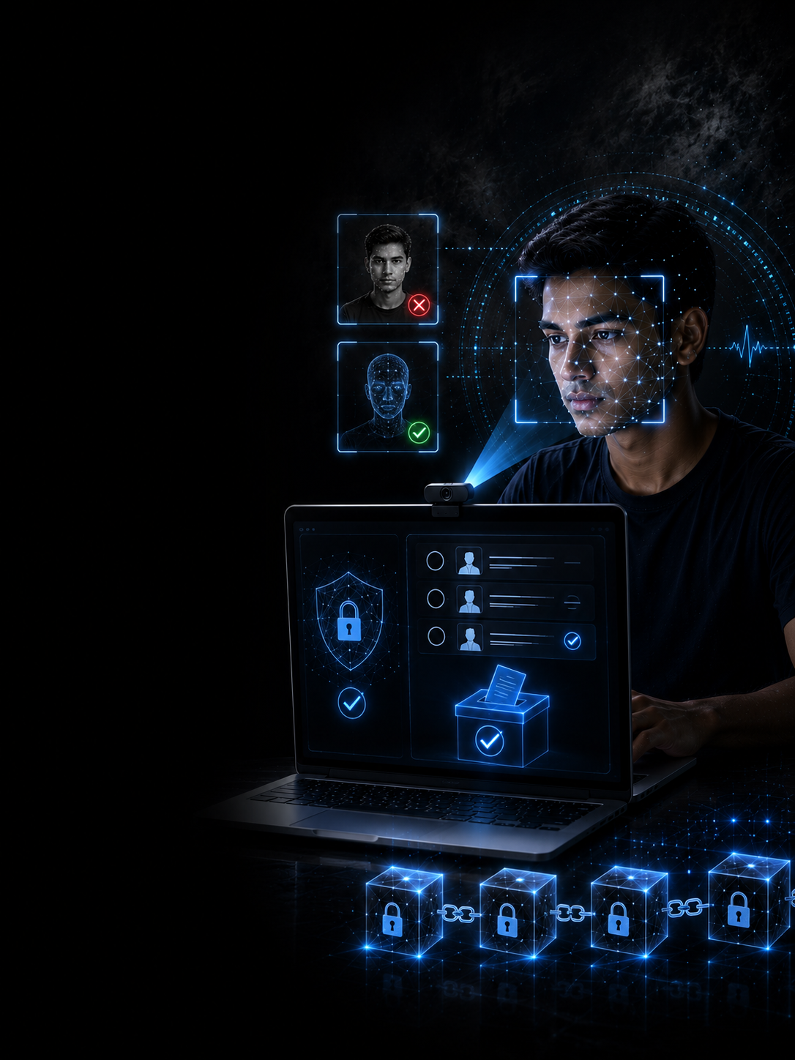
INTRODUCTION
The Shift to Digital Voting:
Voting is moving toward digital, remote and accessible
platforms.
The Security Concern:
Without physical verification, ensuring that the right person casts the vote becomes a critical challenge.
The AI Opportunity:
Facial biometrics can strengthen voter identification,
while liveness detection adds a layer of protection against spoofing.
Our Direction:
Authenticate the voter. Verify the live presence. Protect the vote.

Slide 3
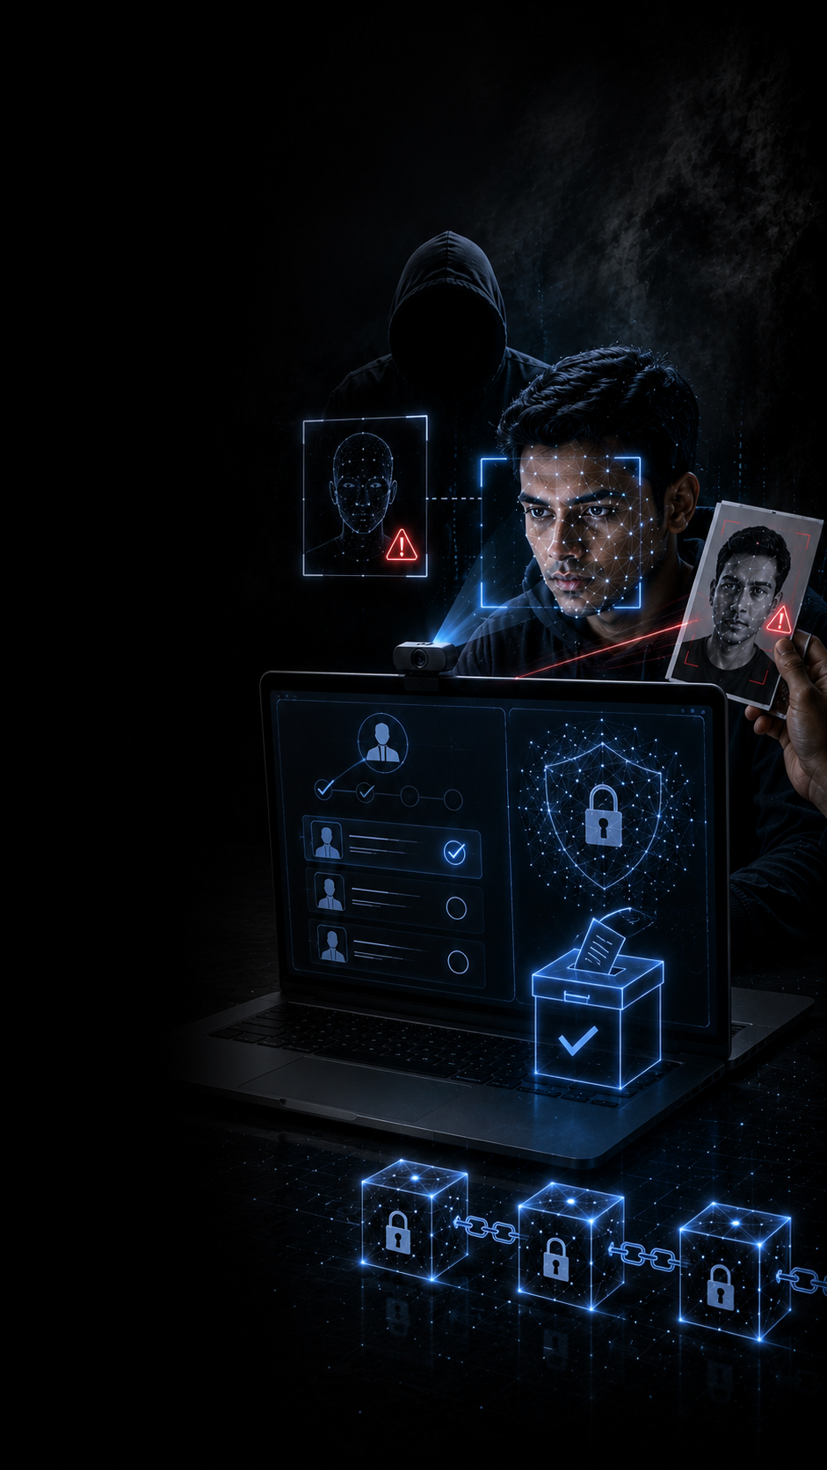
PROBLEM STATEMENT
01. Voter Impersonation
Difficulty in reliably verifying that the person casting the vote is the legitimate registered voter.
02. Facial Spoofing
Conventional face recognition can verify facial identity but cannot by itself confirm live physical presence.
03. Vote Integrity
Online voting requires protection against duplicate voting and unauthorized modification of recorded votes.

Slide 4
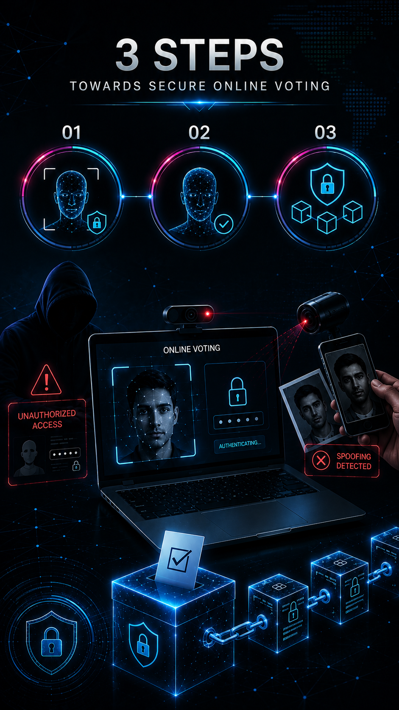
OBJECTIVES
01. Secure Voter Authentication
Strengthen voter verification using OTP and facial recognition.
02.Liveness-Based Spoofing Prevention
Verify that the authenticated face belongs to a live voter, not a static image.
03. Secure & Verifiable Voting
Prevent duplicate voting and maintain tamper-evident vote records using a SHA-256 blockchain ledger.

Slide 5
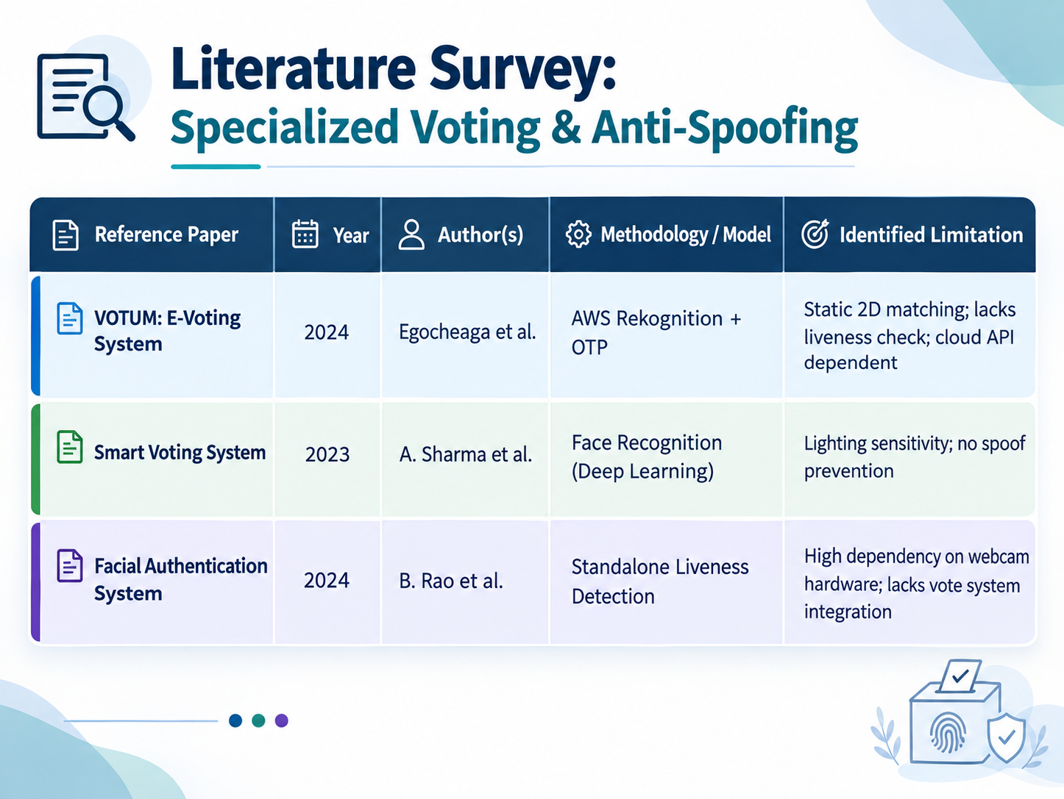

Slide 6
RESEARCH GAP & PROPOSED IMPROVEMENT
Base Paper : “VOTUM: Secure and Transparent E-Voting System” (2024)
Limitations of the Existing VOTUM Project
No dedicated liveness detection
Does not explicitly prevent photo/static-image spoofing
Tested with only 31 participants
Primarily designed for university elections
Scalability needs improvement
Blockchain-based immutability is not currently implemented
Your Proposed Enhancement
Face Recognition → Liveness Detection → OTP → Secure Voting

Slide 7
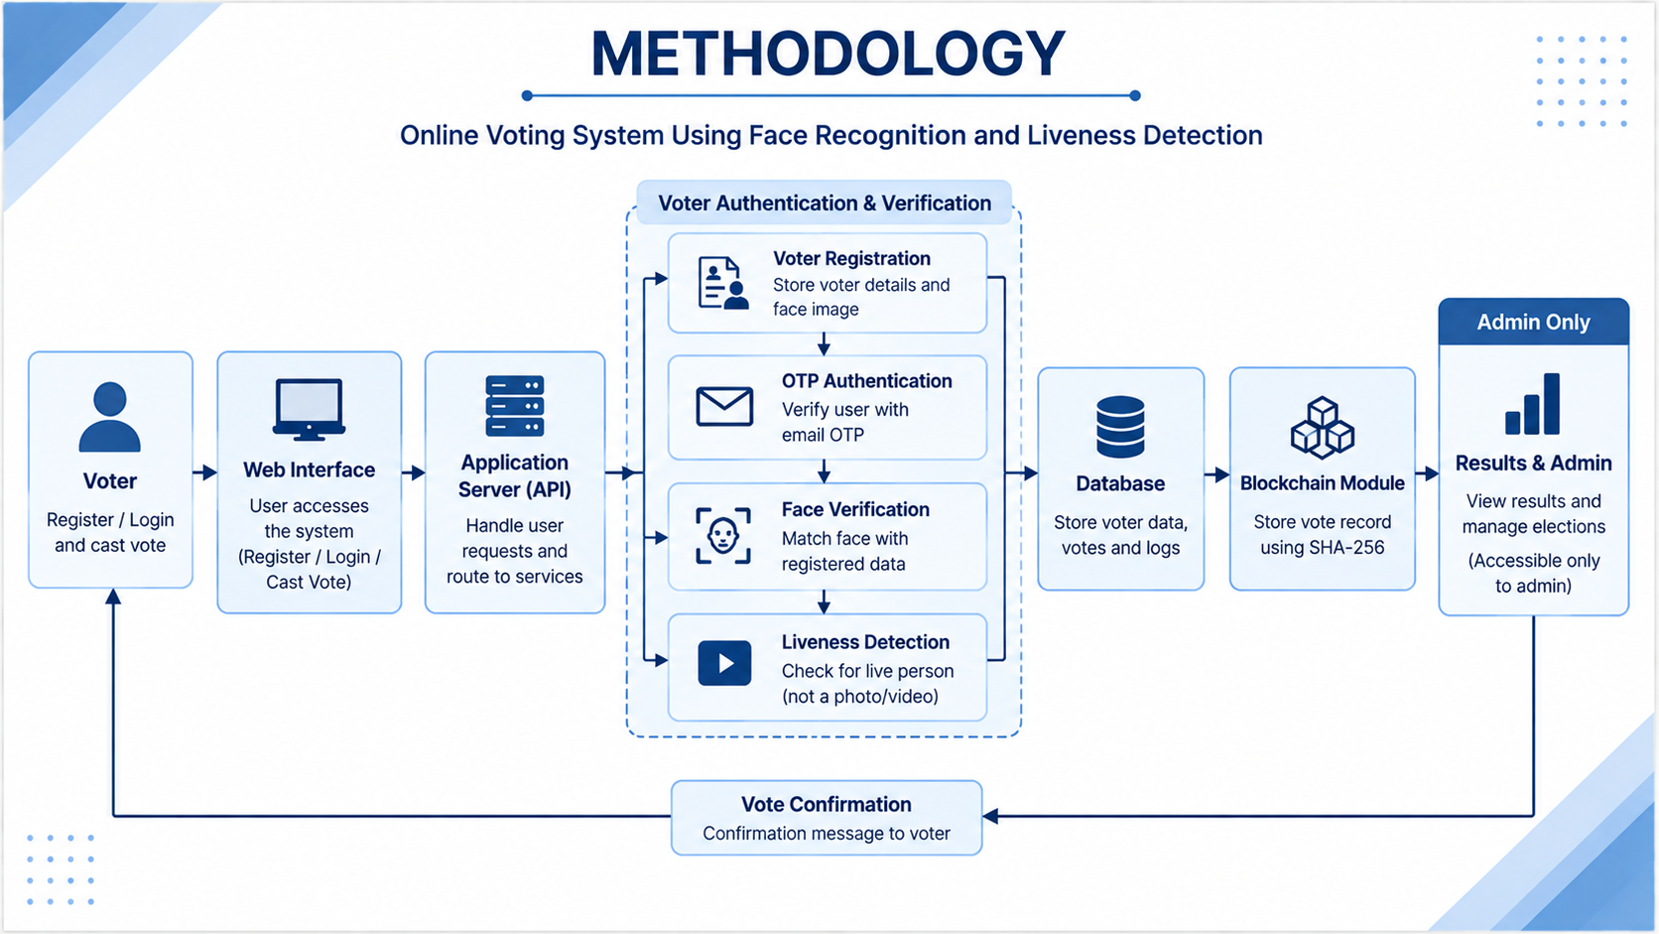

Slide 8
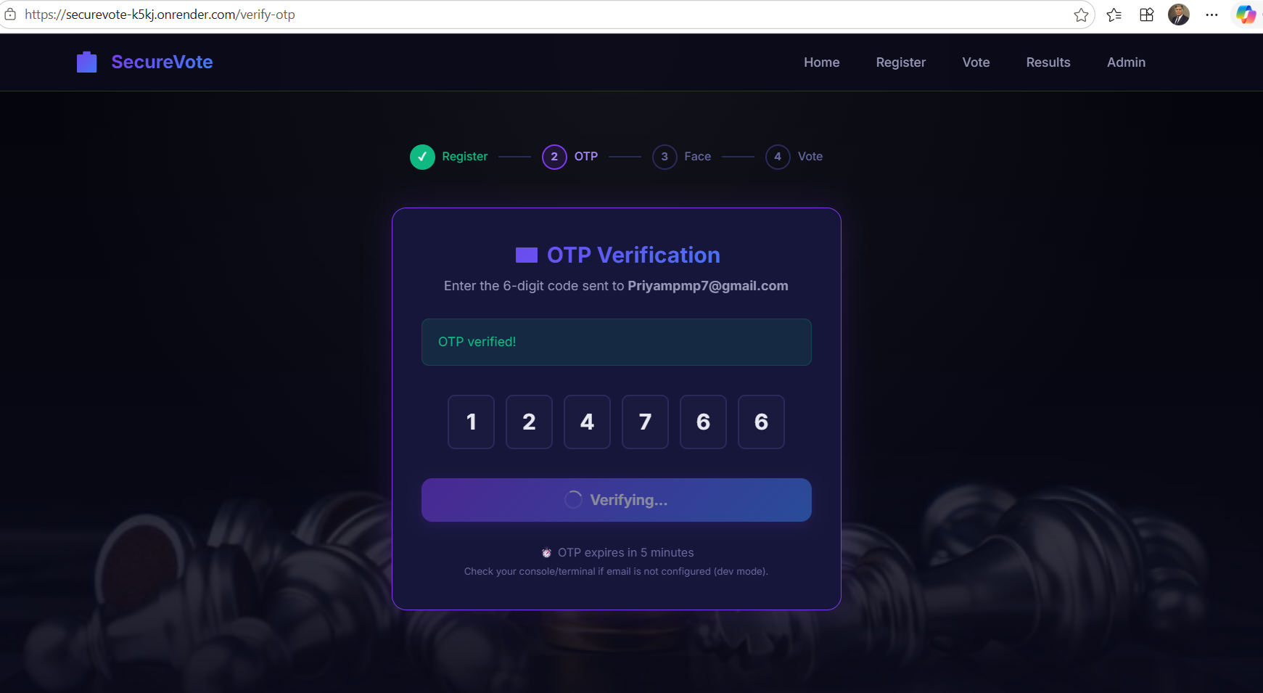
EXPECTED RESULTS
01. Secure Voter Authentication
Successful verification of voters using OTP and facial recognition, ensuring that only authenticated users can proceed.

Slide 9
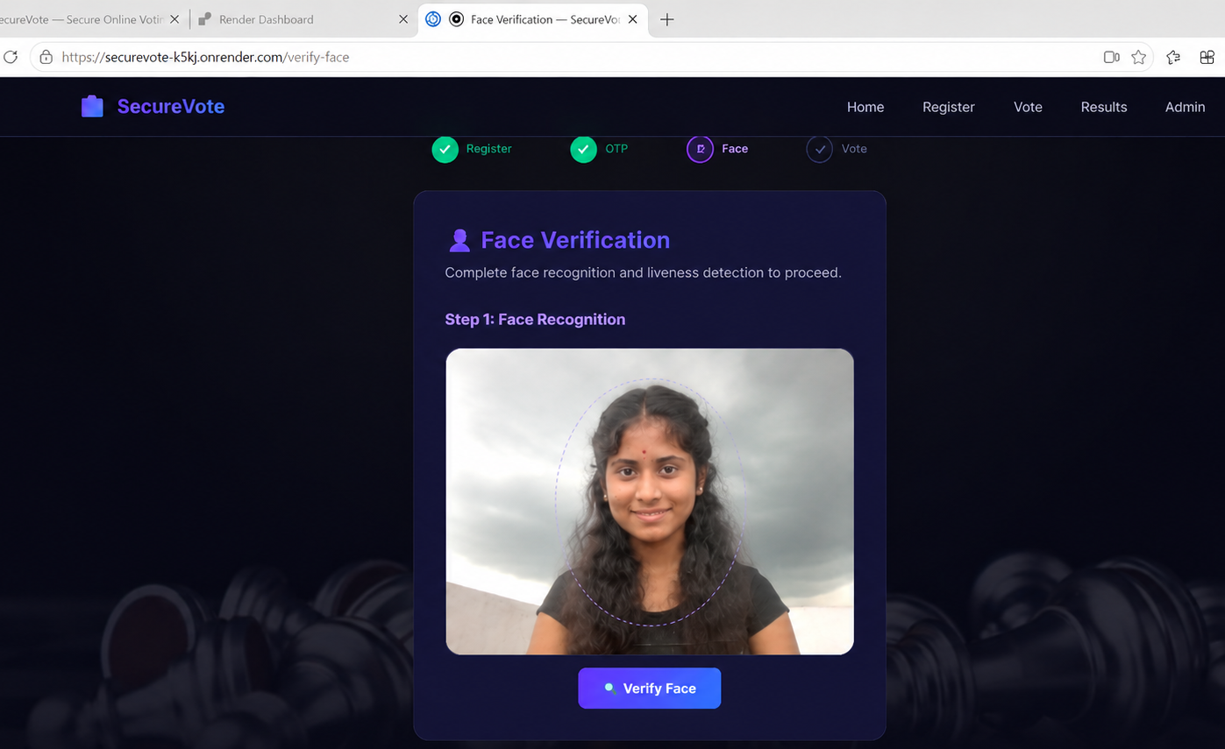
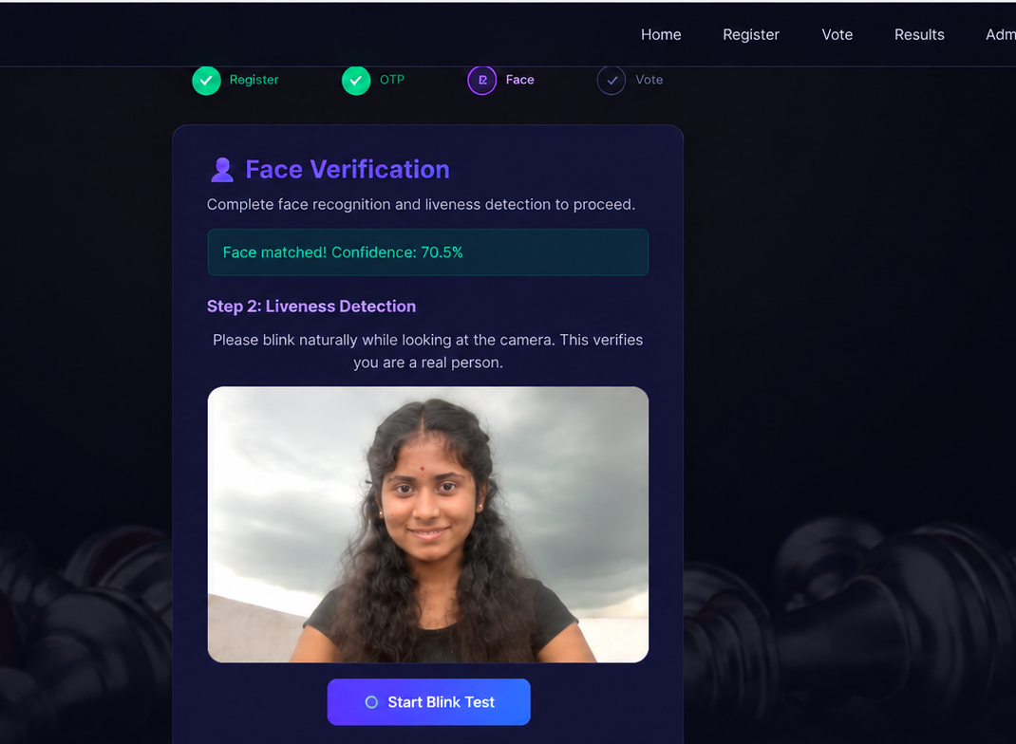
02. Effective Liveness Detection
Detection of whether the voter is a real live person, reducing the risk of spoofing through photographs or static images.

Slide 10

3.Duplicate Voting Prevention
The system detects voters who have already voted and prevents them from casting another vote.

Slide 11
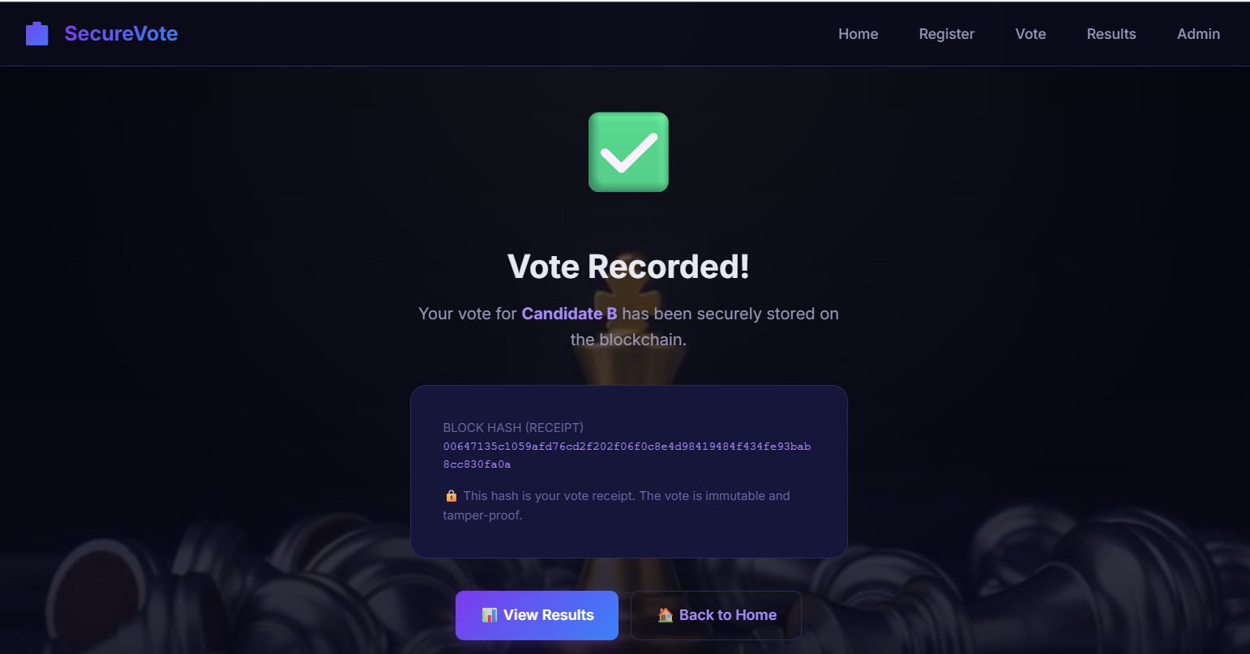
4.Secure & Verifiable Voting
Verified votes are securely recorded with tamper-evident blockchain records using SHA-256.

Slide 12
FUTURE WORK
01. Advanced Deepfake & Presentation-Attack Detection
Improve liveness verification to defend against sophisticated spoofing, deepfakes, and AI-generated facial attacks.
02. Scalable Cloud & Mobile Deployment
Extend the system for cloud-based infrastructure and build mobile applications to enable accessible and secure voting.
03. Large-Scale Election Evaluation
Evaluate system performance, authentication reliability, and scalability with larger voter populations and real-world deployment scenarios.

Slide 13
REFERENCES
[1] A. B. Carter and D. E. Johnson, "Secure Voting Systems: A Review of the Application of Biometrics," Journal of Cybersecurity and Digital Forensics, vol. 11, no. 3, pp. 145-159, 2023.
[2] B. F. Allen and C. D. Wright, "Implementing Iris Recognition in Electoral Systems: Challenges and Solutions," IEEE Transactions on Pattern Analysis and Machine Intelligence, vol. 39, no. 6, pp. 1234-1246, 2023.
[3] E. G. Harris and F. I. Thompson, "Comparative Analysis of Biometric Technologies for Secure Authentication," Proceedings of the International Conference on Security & Privacy, pp. 542- 549, 2022.
[4] G. J. Kumar and H. L. Roberts, "Enhancing Voter Authentication with Iris Recognition Technology," IEEE Access, vol. 8, pp. 7765-7772, 2023.
[5] I. J. Lee, K. M. Park, and L. O. Neil, "Advanced Algorithms for Iris Pattern Recognition: A Survey," Journal of Computer Vision and Image Understanding, vol. 117, no. 8, pp. 847-862, 2023.
[6] M. N. O'Brien and P. Q. Zhang, "Blockchain-Based Voting Systems: Ensuring Integrity and Confidentiality," IEEE Transactions on Information Forensics and Security, vol. 18, no. 4, pp. 950-965, 2023.
[7] Q. R. Stewart and S. T. Jackson, "The Impact of Remote Voting Technologies on Electoral Participation: An Empirical Study," IEEE Journal of Selected Topics in Signal Processing, vol. 13, no. 1, pp. 204-213, 2023.
[8] R. U. Patel and V. W. Singh, "Privacy Concerns and Solutions in Biometric Voting Systems," Proceedings of the IEEE Symposium on Privacy-Aware Computing, pp. 322-331, 2022.
[9] S. V. Kumar, T. X. Pham, and U. Z. Iqbal, "Design and Implementation of a Secure Electronic Voting System Using Iris Recognition," IEEE Systems Journal, vol. 17, no. 2, pp. 1745- 1756, 2023.
[10]T. Y. Wong and A. R. Gupta, "A Review of Iris Recognition Algorithms for Security Systems," IEEE Transactions on Circuits and Systems for Video Technology, vol. 33, no. 7, pp. 2330-2340, 2023.

